Slide 1

Hybrid Azure Management
Sarah Lean
Senior Cloud Advocate
Microsoft
@Techielass
www.techielass.com

Slide 2



Who am I?
Senior Cloud Advocate @ Microsoft
Blog at www.techielass.com
@Techielass
Founder of the Glasgow Azure User Group
STEM Ambassador
14+ years in the IT industry
IT Pro

Slide 3

Scotland is the home of…
ptarmigan
Microsoft Azure | @Techielass

Slide 4
Hybrid Cloud
Learn about customer challenges and how they can address these by using Azure hybrid services and what the different hybrid cloud approaches are.
Tailwind Traders Challenges
We are going to have a look at the challenges Tailwind Traders is going to solve using hybrid services.
Microsoft Azure | @Techielass

Slide 5









IT environments are evolving
10s - 1,000s of apps
Diverse infrastructure
Multi-cloud
VMs
Databases
Datacenters
Hosters
Containers
Serverless
Branch offices
OEM hardware
IoT devices
Edge
Microsoft Azure | @Techielass

Slide 6


Slide 7
Tailwind Traders challenges
Ensure their website can scale with the traffic being generated
Ensure that software updates to servers are deployed in a timely manner across clouds and on-prem
Ensure that their file servers are replicated, have enough capacity and are protected
Ensure that all their servers are organized and governed across environments
Microsoft Azure | @Techielass

Slide 8

THE WEBSITE

Slide 9


Solution
+

Slide 10
Traffic Manager
Traffic Manager
DNS-based load balancer
Supports external, non-Azure endpoints
Hybrid cloud and on-premises deployments
Public facing endpoint
Routing methods
Priority, weighted, performance, geography, subnet, multi-value
Microsoft Azure | @Techielass

Slide 11
How does it work
www.tailwindtraders.com
CNAME
tailwind.trafficmanager.net
Load-balancing and
Endpoint monitoring
Cloud service
Azure web site
Non-Azure
Endpoints
Microsoft Azure | @Techielass

Slide 12


External Endpoints
Traffic Manager supports endpoints outside of Azure
Simply specify an arbitrary DNS name, e.g. mysite.tailwindtraders.com
Works with all traffic-routing methods
Enables a variety of ‘hybrid’ scenarios
Smooth migration from on-premises to Cloud
Geo-expansion of existing applications
Burst-to-Cloud
Failover-to-Cloud
Traffic Manager
Azure Endpoint
On-Premises Endpoint
Microsoft Azure | @Techielass

Slide 13
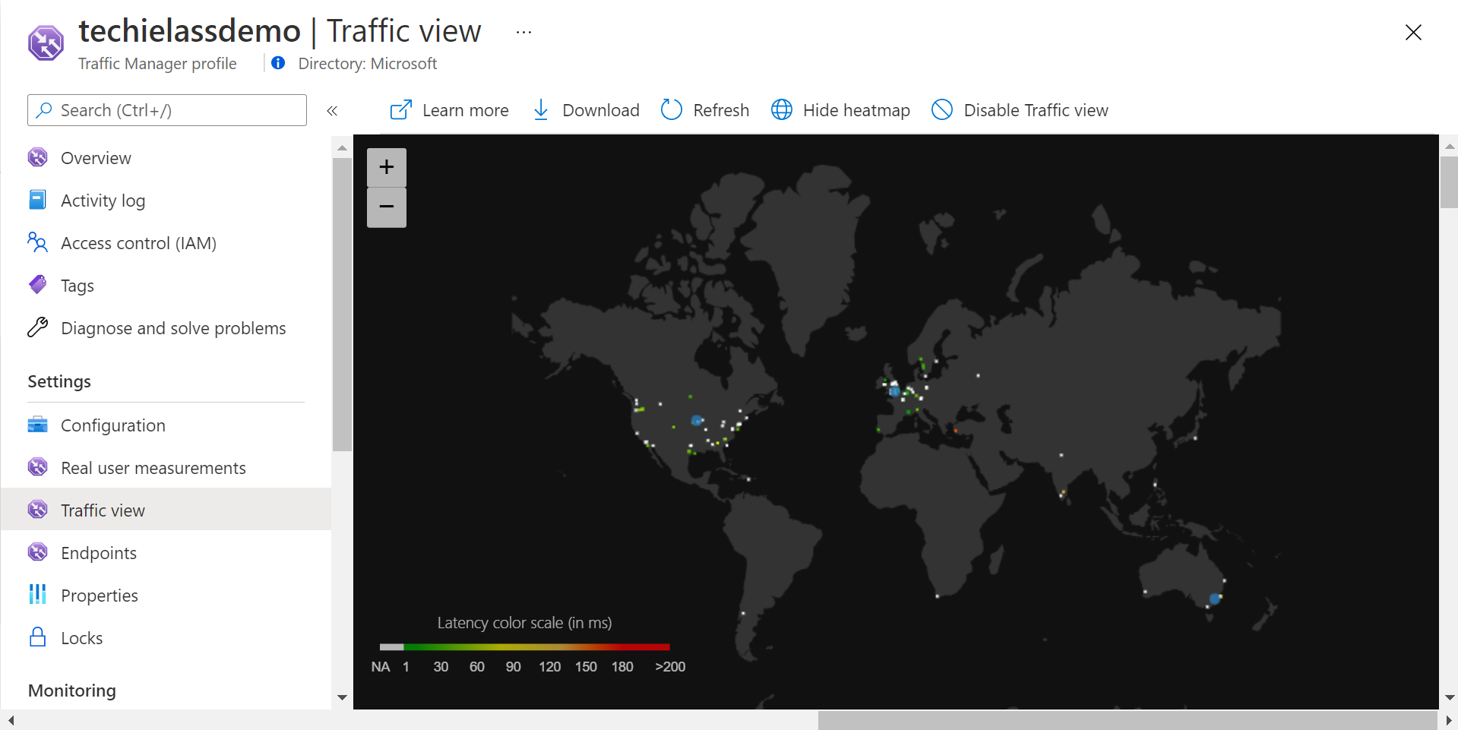
Traffic View
Traffic View
Use the data
Understand more about your users
Understand your user’s experience
Make informed decisions
Microsoft Azure | @Techielass

Slide 14

Server
management

Slide 15
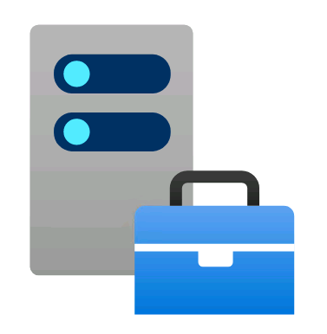
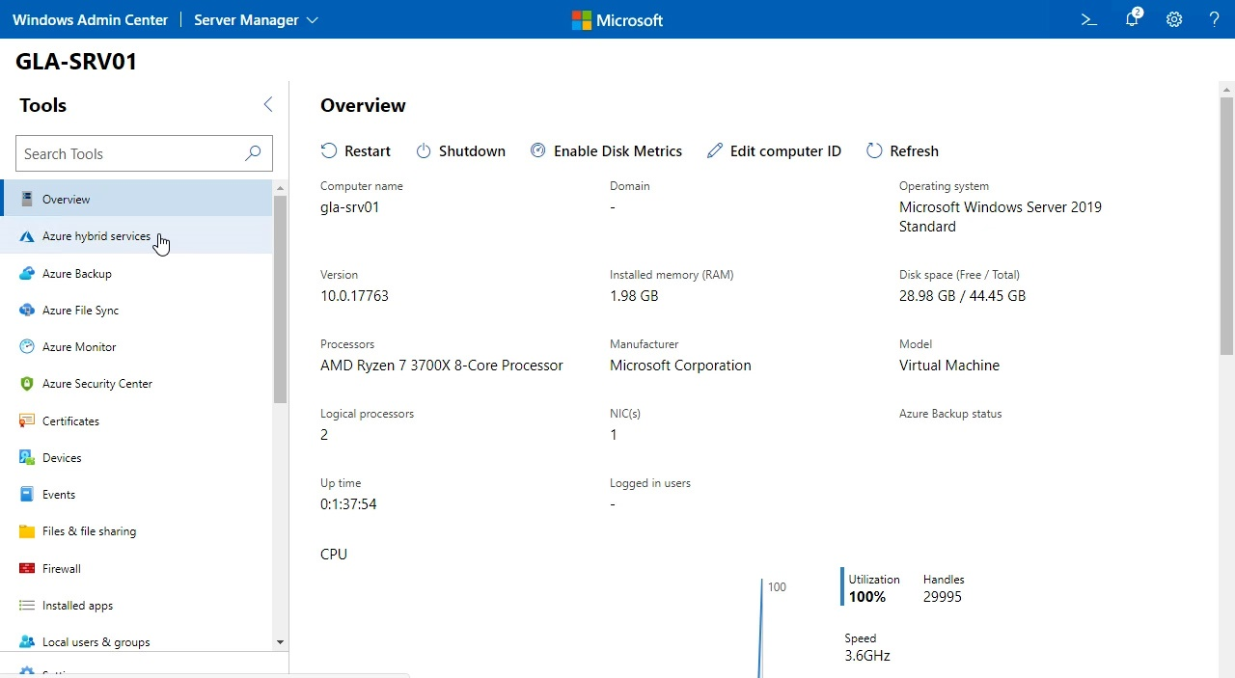
Windows Admin Center
Remote management tool for Windows Servers running anywhere—physical, virtual, on-premises, in Azure, or in a hosted environment—at no additional cost
http://aka.ms/WACDownload
Microsoft Azure | @Techielass

Slide 16
Server management reimagined
Manage systems, including multiple versions of Windows Server
Bolster network security
Keep local files in sync with the cloud
Apply updates
Streamline everyday tasks on premises
Add hybrid capabilities
Monitor server performance
Back up servers
Protect servers intelligently
Predict capacity needs
Resolve server issues
Maximize performance, availability
Microsoft Azure | @Techielass

Slide 17














Extend on-premises into Azure
Business continuity & disaster recovery
Centrally manage from Azure
Secure
Monitor
Update
Azure Site Recovery
Azure Backup
Storage Replica
Azure Security Center
Azure Monitor
Azure Update Management
Extend on-premises capacity
Storage
Azure File Sync
Storage Migration Service
Compute
Cloud Witness
Create Azure VM
Azure Arc for Servers
Azure Policy
Networking
Azure Network Adapter
Azure Extend Network
Microsoft Azure | @Techielass

Slide 18











Windows Admin Center Partners
Microsoft Azure | @Techielass

Slide 19
Download today
The small (~60MB) file installs in minutes and is available at no extra cost. Access from a modern web browser.
LEARN MORE
https://aka.ms/hybrid-wac
Microsoft Azure | @Techielass

Slide 20
Demo – Windows Admin Center Overview

Slide 21
Consistency

Slide 22

Azure Arc
Bring Azure services and management to any infrastructure
Run Azure Data Services anywhere
Extend Azure management across your environments
Adopt cloud practices on-premises
Implement Azure security anywhere
Azure Arc is a set of technologies that extends Azure management and enables Azure services to run across on-premises, multi-cloud, and edge

Slide 23




Azure Arc enabled servers Bring on-premises and multi-cloud servers to Azure with Azure Arc
Reach
Organize and Inventory
Governance and Security
Role-Based Operations
Linux and Windows
VM and Bare-Metal
Domain agnostic
At scale searchable inventory
Unify management experience
Consistent VM extensions
Integrate with Azure Lighthouse
Built-in Azure policies
Server security baselines
Compliance across environments
Centralized agent management – Monitoring, Security, Update Management
Central IT to manage at-scale operations
Workload owners manage based on their access
Any infrastructure, familiar tools

Slide 24
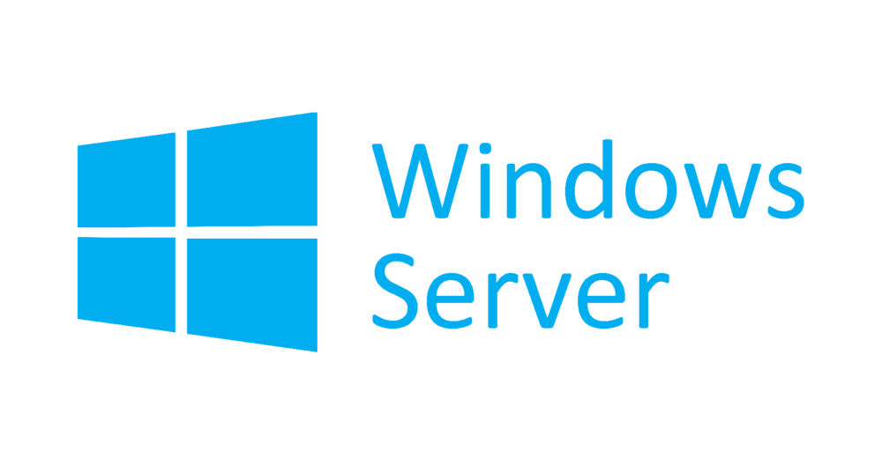




Azure Arc enabled servers Azure Arc enabled servers are auto-enrolled with additional Azure services
Additional services
Azure Policy
Azure Defender
Azure Sentinel
Azure Monitor
Change and inventory tracking
Update management
Azure Security Center
AWS Linux 2
Just turn them on when you want to use them

Slide 25
Demo – Azure Arc

Slide 26
File shares

Slide 27
Demo – Azure File Share

Slide 28




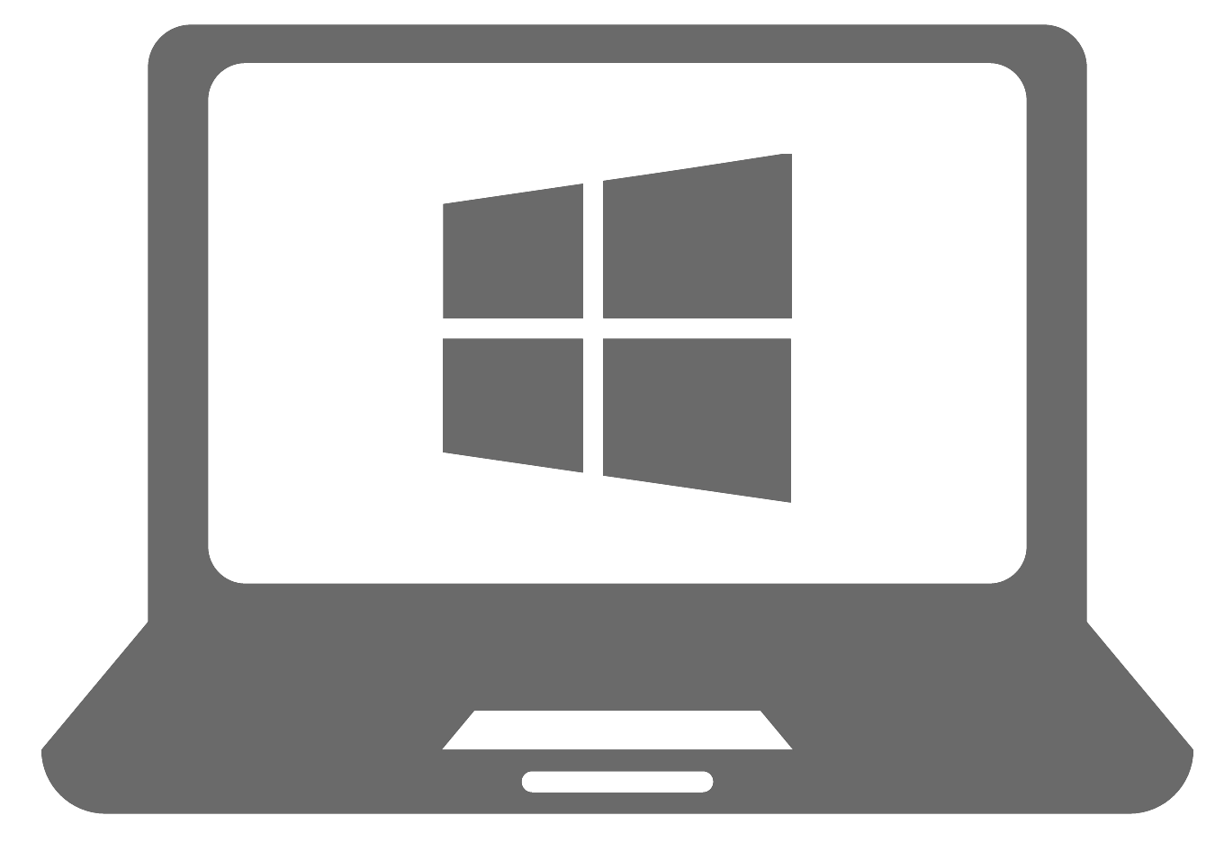




Tailwind Traders using Hybrid file shares via Azure File Sync
Azure File Sync
Cloud Tiering
Cloud Access
Azure Backup
Multi-site Sync
File
Share
Cloud Backup
Rapid File Server DR
SMB
NFS
Work Folders
Users
Applications
File Sync Server 1 Glasgow
File Sync Server 2 Edinburgh
File Sync Server 3 London

Slide 29
Keeping
up to date

Slide 30

Azure Update Management
Assess update status of servers across your environment
Windows, Linux
Azure, other cloud, on-prem Deploy updates
Custom approval criteria
Single pane of glass
Automated periodic deployments
Verify Compliance
Assess Updates
Deploy Updates

Slide 31
Demo – Azure Update Management

Slide 32
Replacement
servers

Slide 33
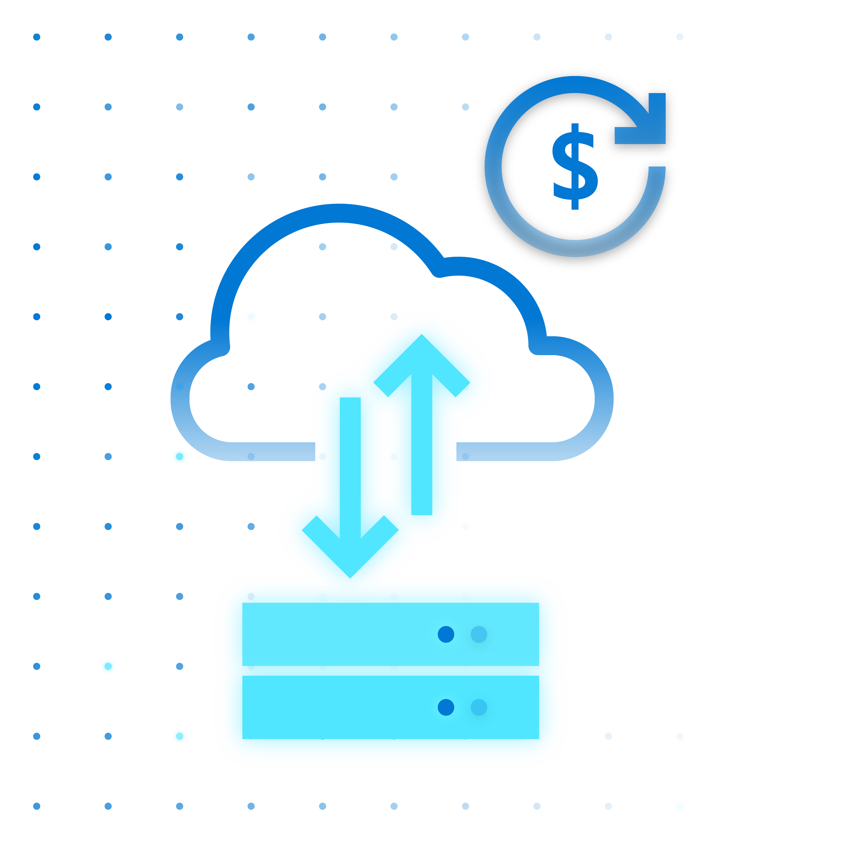



Azure Stack HCI
Modern subscription for flexible, familiar hyperconverged infrastructure
Azure hybrid by design
Enterprise scale and price performance
Familiar management and operations
Choice of deployment options
Microsoft Azure | @Techielass

Slide 34
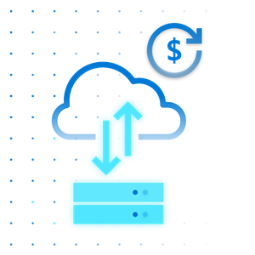
Azure hybrid by design
Azure hybrid by design
Native integration with Azure Arc and Azure Monitor
Connect to hybrid services like Azure Security Center, Azure Backup, and Azure Site Recovery
Monitor and manage clusters at scale from Azure
Centrally manage from Azure Portal
Fleet management for hosts and VMs
Always up to date HCI as a service ​
Regular and consistent feature and security updates
Unified Azure billing
Leverage existing Azure support plan
Microsoft Azure | @Techielass

Slide 35
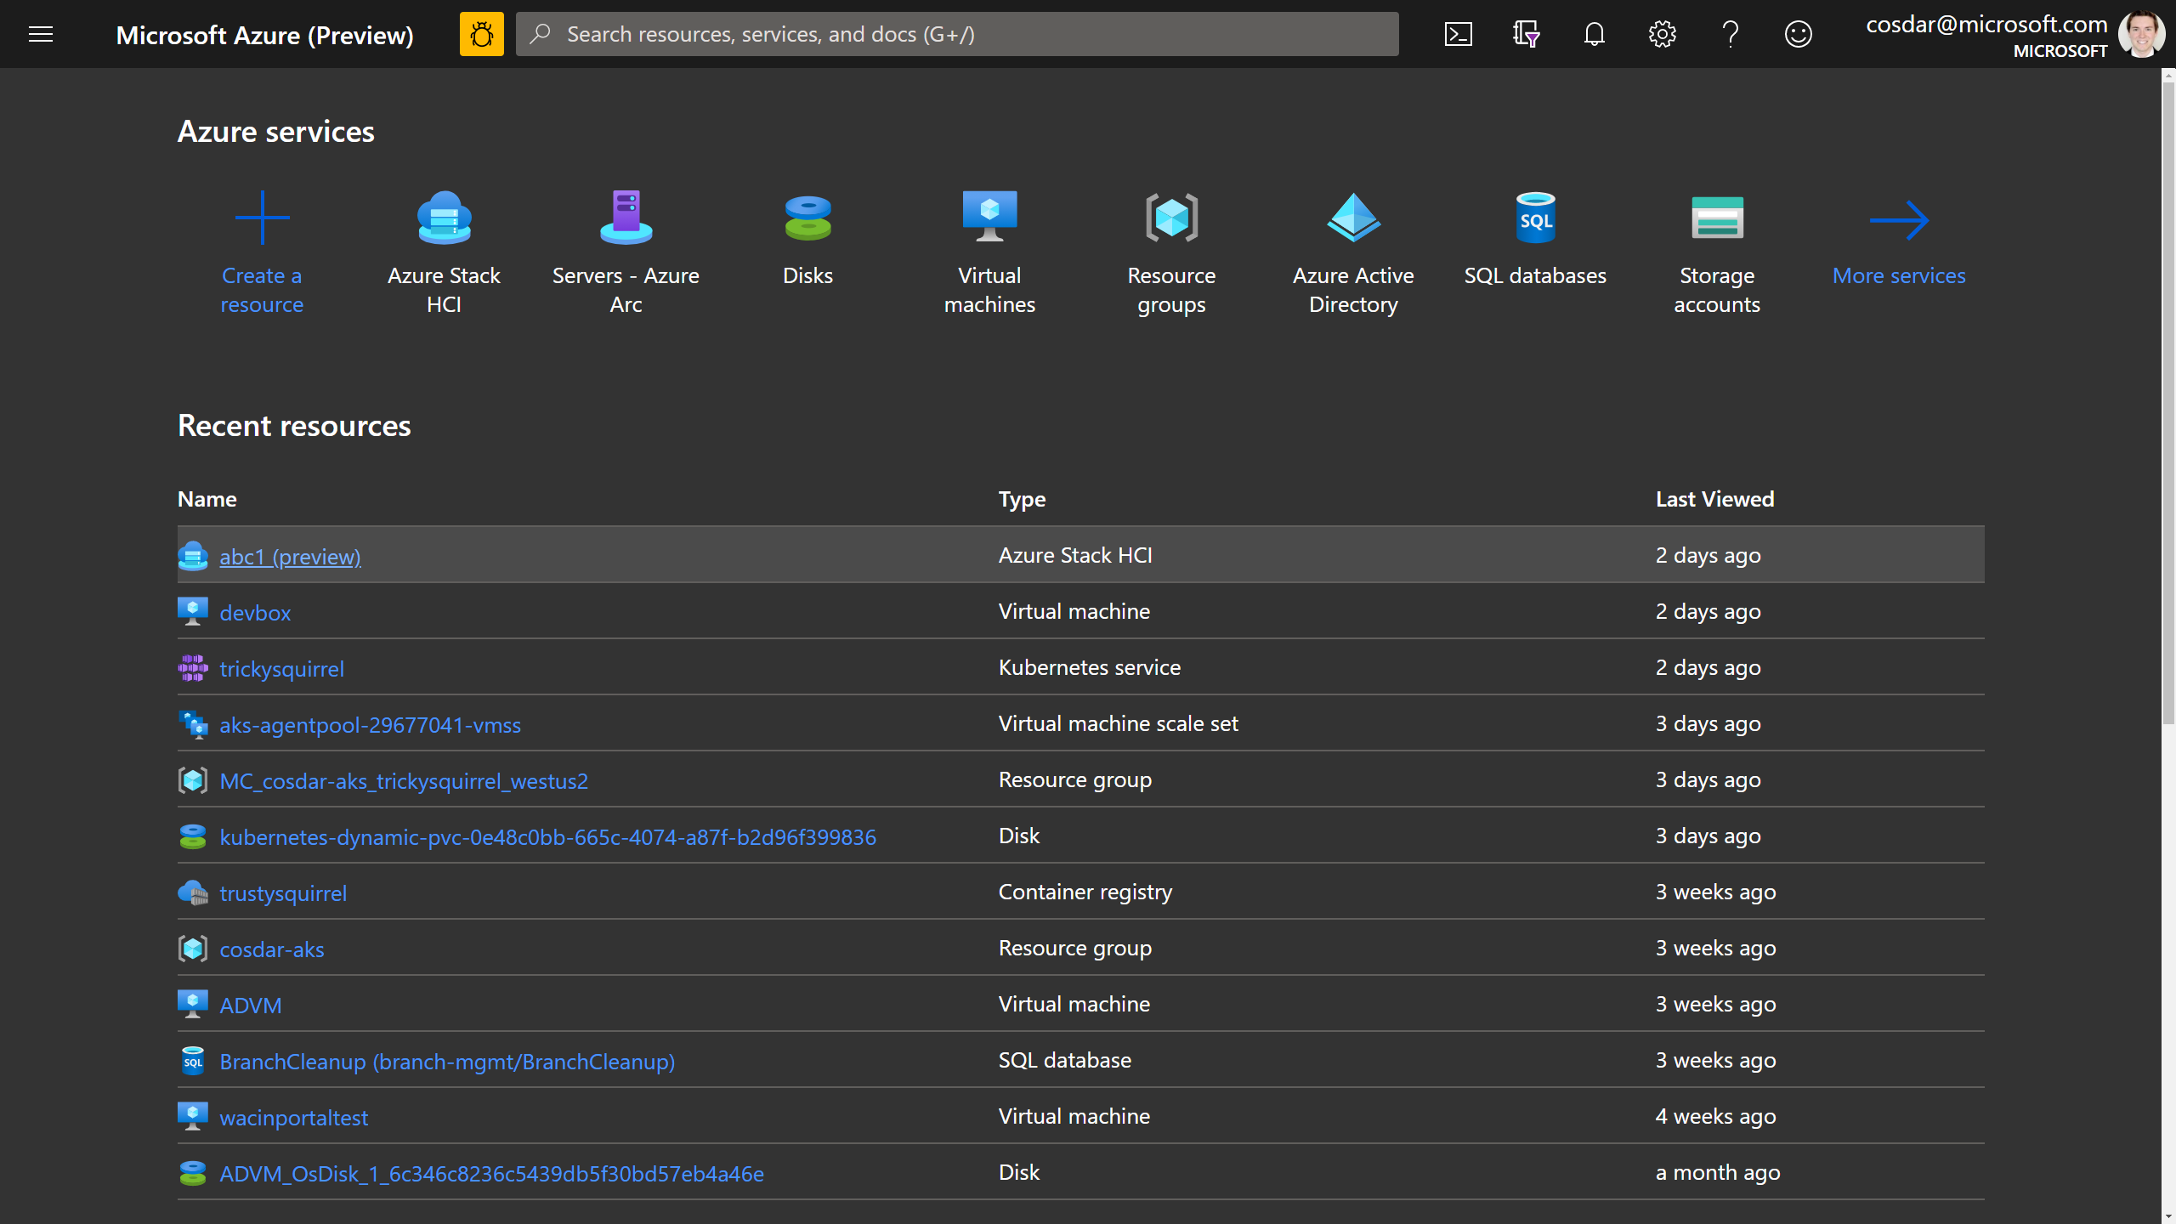



Simplify hybrid with native Azure integration
Azure Resource Manager (ARM) resource represents each on-premises Azure Stack HCI cluster
Visibility in the Azure Portal and foundation for hybrid management
No fuss with agents or scripts – it’s built-in!
Azure Active Directory
Subscription
Azure Stack HCI
Resource Provider
by Microsoft
Resource Group
NEW
Resource for
Azure Stack HCI
Azure Portal
Cloud
On-premises
Server 1
Server 2
Server 3
On-premises cluster
Microsoft Azure | @Techielass

Slide 36

Familiar management and operations
Leverage existing skills
Built on foundation of Windows Server and Hyper-V
Familiar tools like Windows Server Admin Center and Azure Portal
Support for Active Directory, Group Policy Object
Work with popular tools
Work with familiar Microsoft tools such as System Center and Windows Admin Center
Compatible with popular third-party tools such as Altaro, Datadog, Commvault, Veeam, Veritas, etc.
Benefit from automation
Management tasks are completely scriptable using popular, cross-platform Windows PowerShell framework
Microsoft Azure | @Techielass

Slide 37


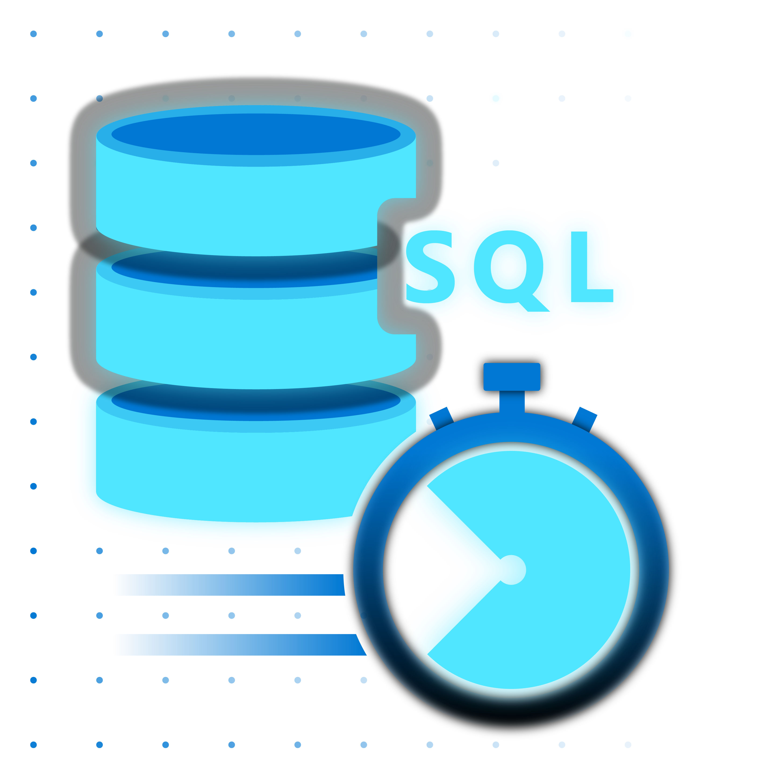




When to use Azure Stack HCI
Run virtual machines on-premises and easily connect to Azure hybrid services
Modernize and secure your datacenter
Industry-best performance for SQL Server databases
Deploy cloud native apps and Azure Arc enabled services
Affordably run intelligent edge and remote branch solutions
Microsoft Azure | @Techielass

Slide 38
In this session you learned about:
Different Hybrid approaches and Azure Hybrid services
Expand your website scalability using Azure Traffic Manager
Leverage Azure Hybrid services like Azure Update Management
Improve file and folder availability in a Hybrid environment with Azure File Sync
Use Azure Arc to govern servers in your hybrid environment
Microsoft Azure | @Techielass

Slide 39

Thank you! Resources: https://aka.ms/azurehybrid-techorama
Sarah Lean
Senior Cloud Advocate
@Techielass
www.techielass.com
Microsoft Azure | @Techielass

